Slide 1



Blockchain Technology- Transportation of sensitive goods
Guided By:
Prof. Sofoklis Efremidis
Presented By:
Shardul Kulkarni
Kedar Kshatriya
Ria Dhanani
Udaykumar Shelke
Shruti Navale

Slide 2
Agenda
Introduction to Blockchain
Objective
Why this System is Needed ?
Proposed System
Model layout
Benefits of Blockchain
Smart Contract and its advantages
Technologies to be used
Internet of Things(IoT),Web3.js
Working Model
Progress Report
Conclusion
References

Slide 3
Introduction to Blockchain
Blockchain can be defined as an open, distributed ledger that can record transactions between two parties efficiently ,which are permanently stored in blocks.
A blockchain carries no transaction cost.
The blockchain is a simple, yet ingenious way of passing information from A to B in a fully automated and safe manner.

Slide 4
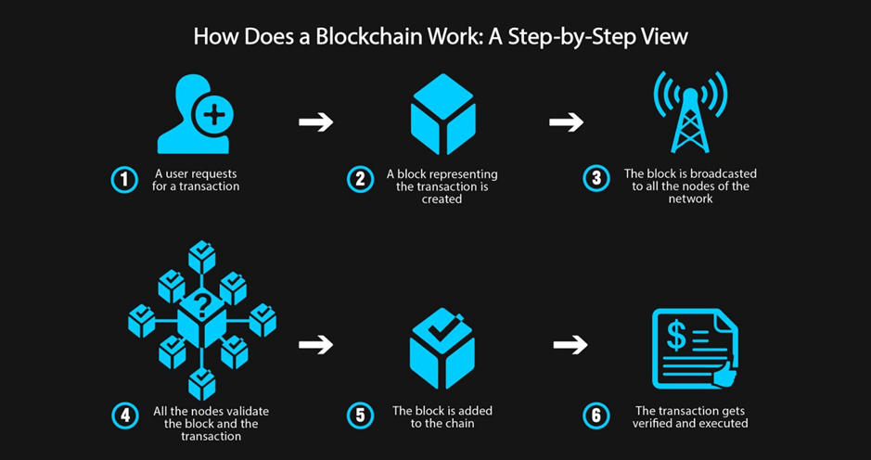

Slide 5
Objective
To develop Decentralized Autonomous System for transportation of Sensitive goods.
To develop a Supply Chain for Transportation & Funds Transfer.
Smart contracts cut costs and eliminate middlemen.
Each product gets a specific tag, which allows us to secure the supply chains with just a few clicks.

Slide 6
Why this System is Needed ?
Transparent and Trackable.
Secure and Authorized Transactions and digital ledgers.
Creates trust among several individuals and entities.
Keeps the track and information about product to every stake holder.
No paperwork.

Slide 7
Proposed System
A Decentralized autonomous system for transportation of sensitive goods and the fund transfer between different entities .
Permission rights and authentication for every entities are defined.
Whole process is governed by smart contracts.
Payments through the cryptocurrencies can be done.
Automatically change of ownership of product from one entity to another.
A peer to peer transaction of funds and energy according to need.

Slide 8
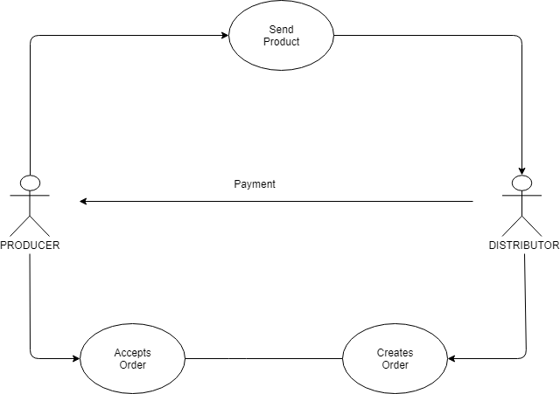
Model Layout
START

Slide 9
Benefits of Blockchain
Faster settlement
Immutable
Increase network capacity
More secured
Decentralized
Shared and distributed

Slide 10
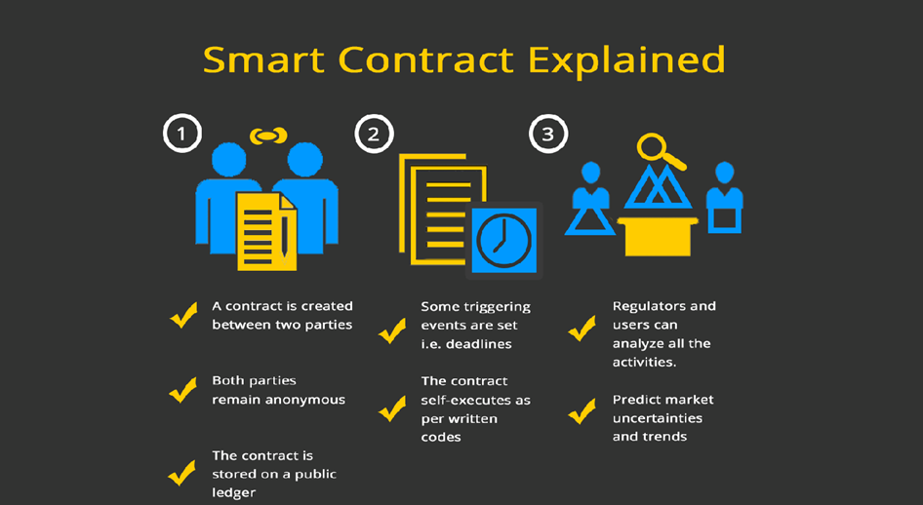
Smart Contracts
A smart contract is a computer protocol intended to digitally facilitate, verify, or enforce the negotiation or performance of a contract.

Slide 11
Advantages of Smart Contract
Total transparency
No Miscommunication
Efficient Performance
No Paperwork
Backup
Trustworthy
Guaranteed Outcomes

Slide 12
Technologies Used
Ethereum Blockchain(Remix IDE)
Solidity Programming
-Used to design and code various contracts.
Digital Payment Transfer(Metamask).
Internet of Things(IoT)
Web3.js

Slide 13
Internet of Things
The Internet of things (IoT) is the extension of Internet connectivity into physical devices and everyday objects. Embedded with electronics, Internet connectivity, and other forms of hardware (such as sensors), these devices can communicate and interact with others over the Internet, and they can be remotely monitored and controlled.
The global supply chain is multi-layered and involves hundreds of parties across time zones. Moving the supply chain to the blockchain is often discussed by distributed ledger enthusiasts. From food distributors, many supply chains could benefit from using a combination of IoT and blockchain to streamline processes.
Transfer of ownership and location could be tracked in real-time between IoT instruments, the freights themselves or each object individually.

Slide 14
Web3js
Web3.js talks to The Ethereum Blockchain with JSON RPC, which stands for "Remote Procedure Call" protocol.
Web3.js allows us to make requests to an individual Ethereum node with JSON RPC in order to read and write data to the network.
Web3.js forms a link between all the solidity contracts executed on remix platform and the Graphical User Interface(GUI).

Slide 15
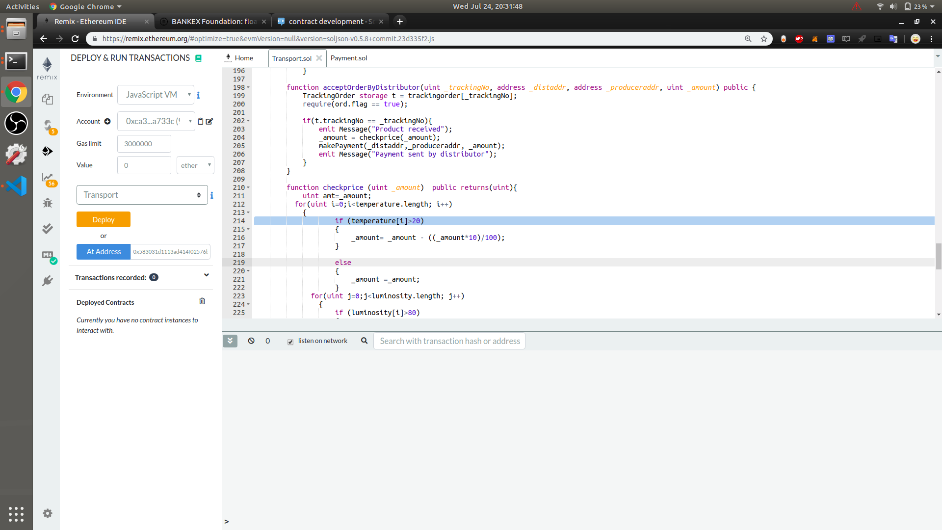
PRIOR TO DEPLOYMENT

Slide 16
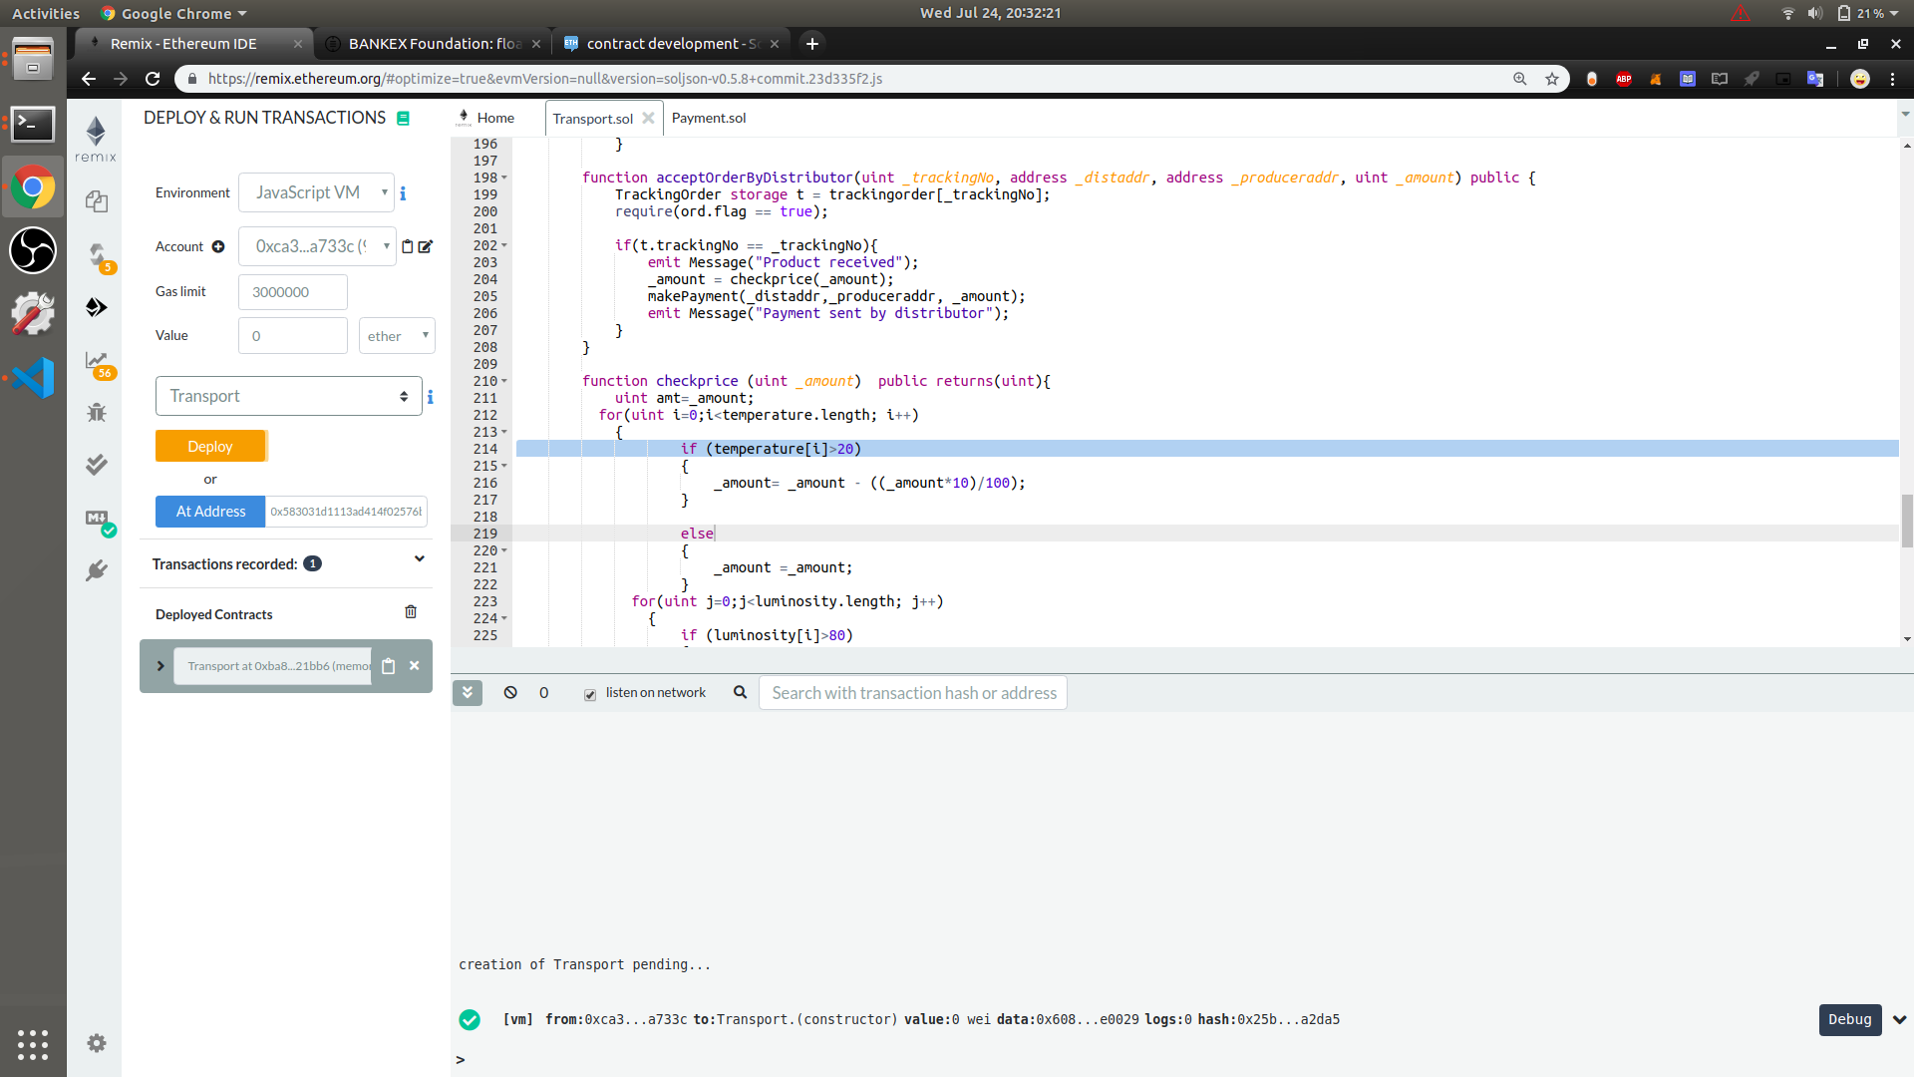
AFTER DEPLOYMENT

Slide 17
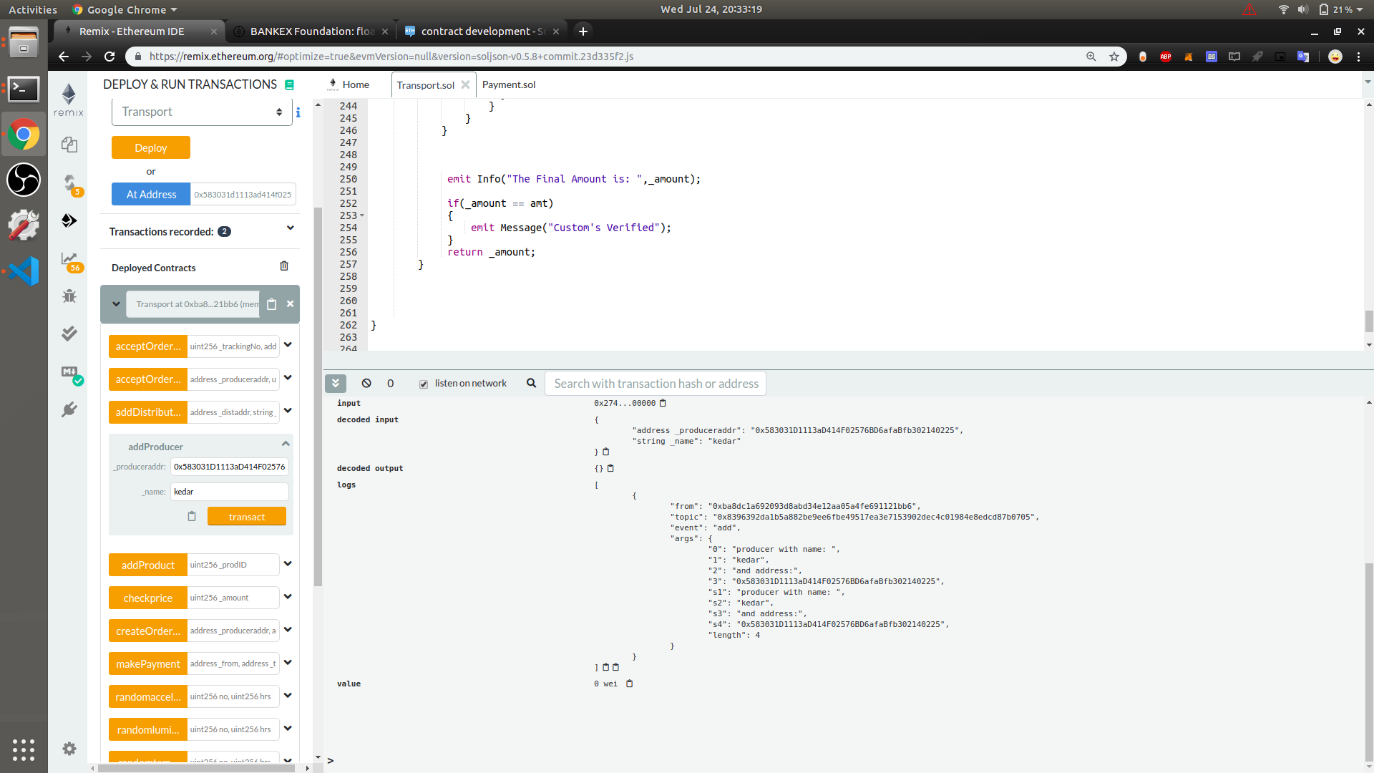
ADDING PRODUCER

Slide 18
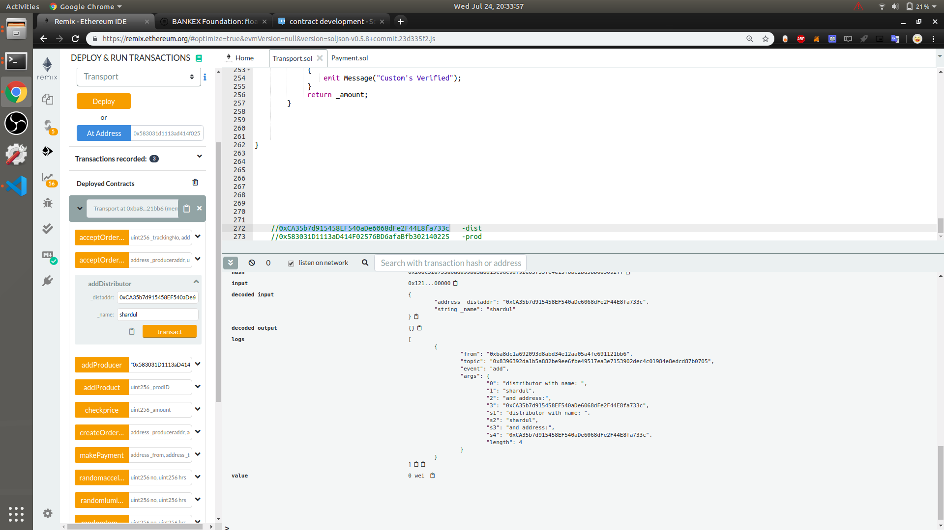
ADDING DISTRIBUTOR

Slide 19
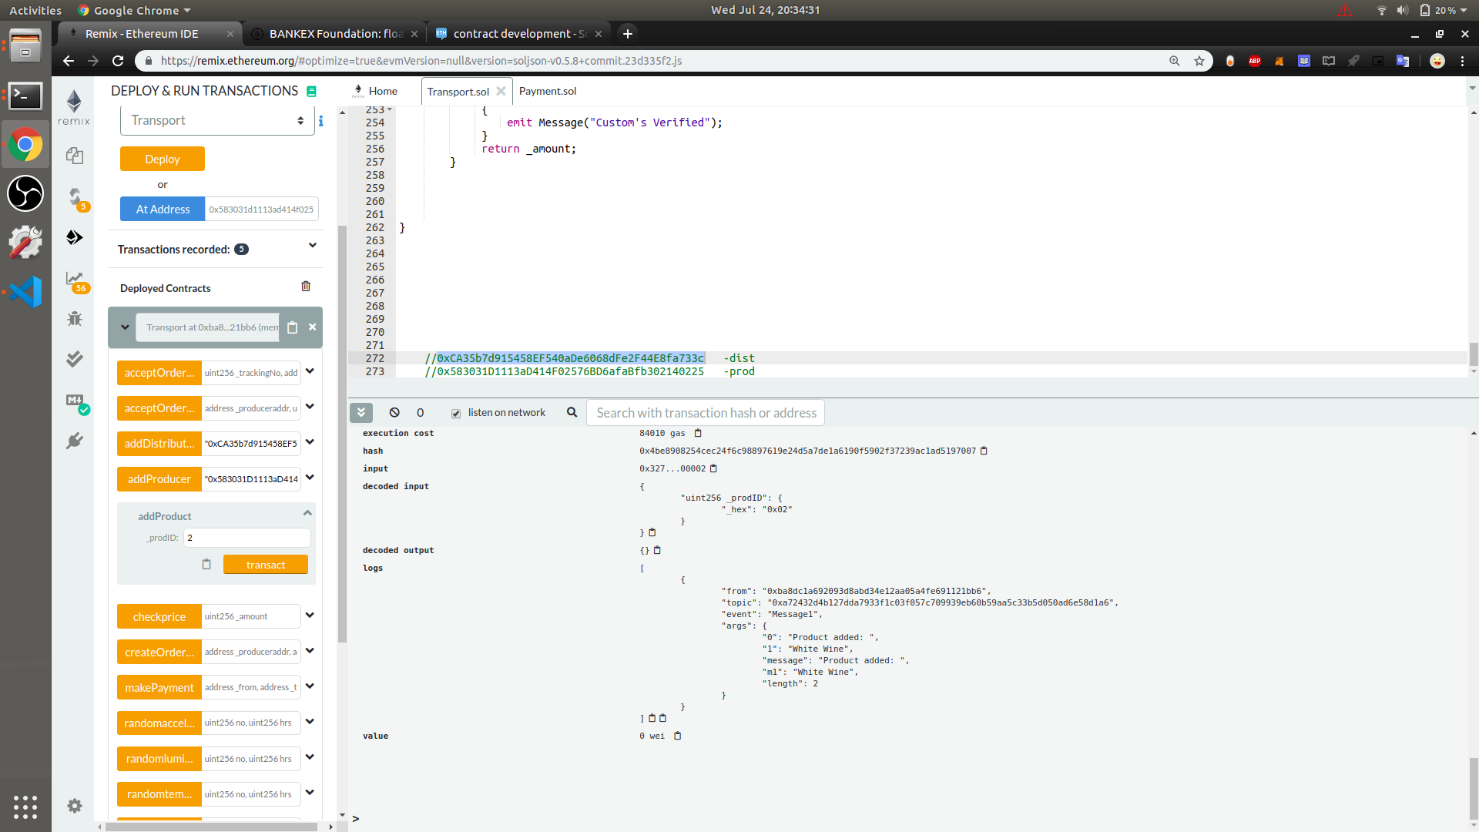
ADDING PRODUCT

Slide 20
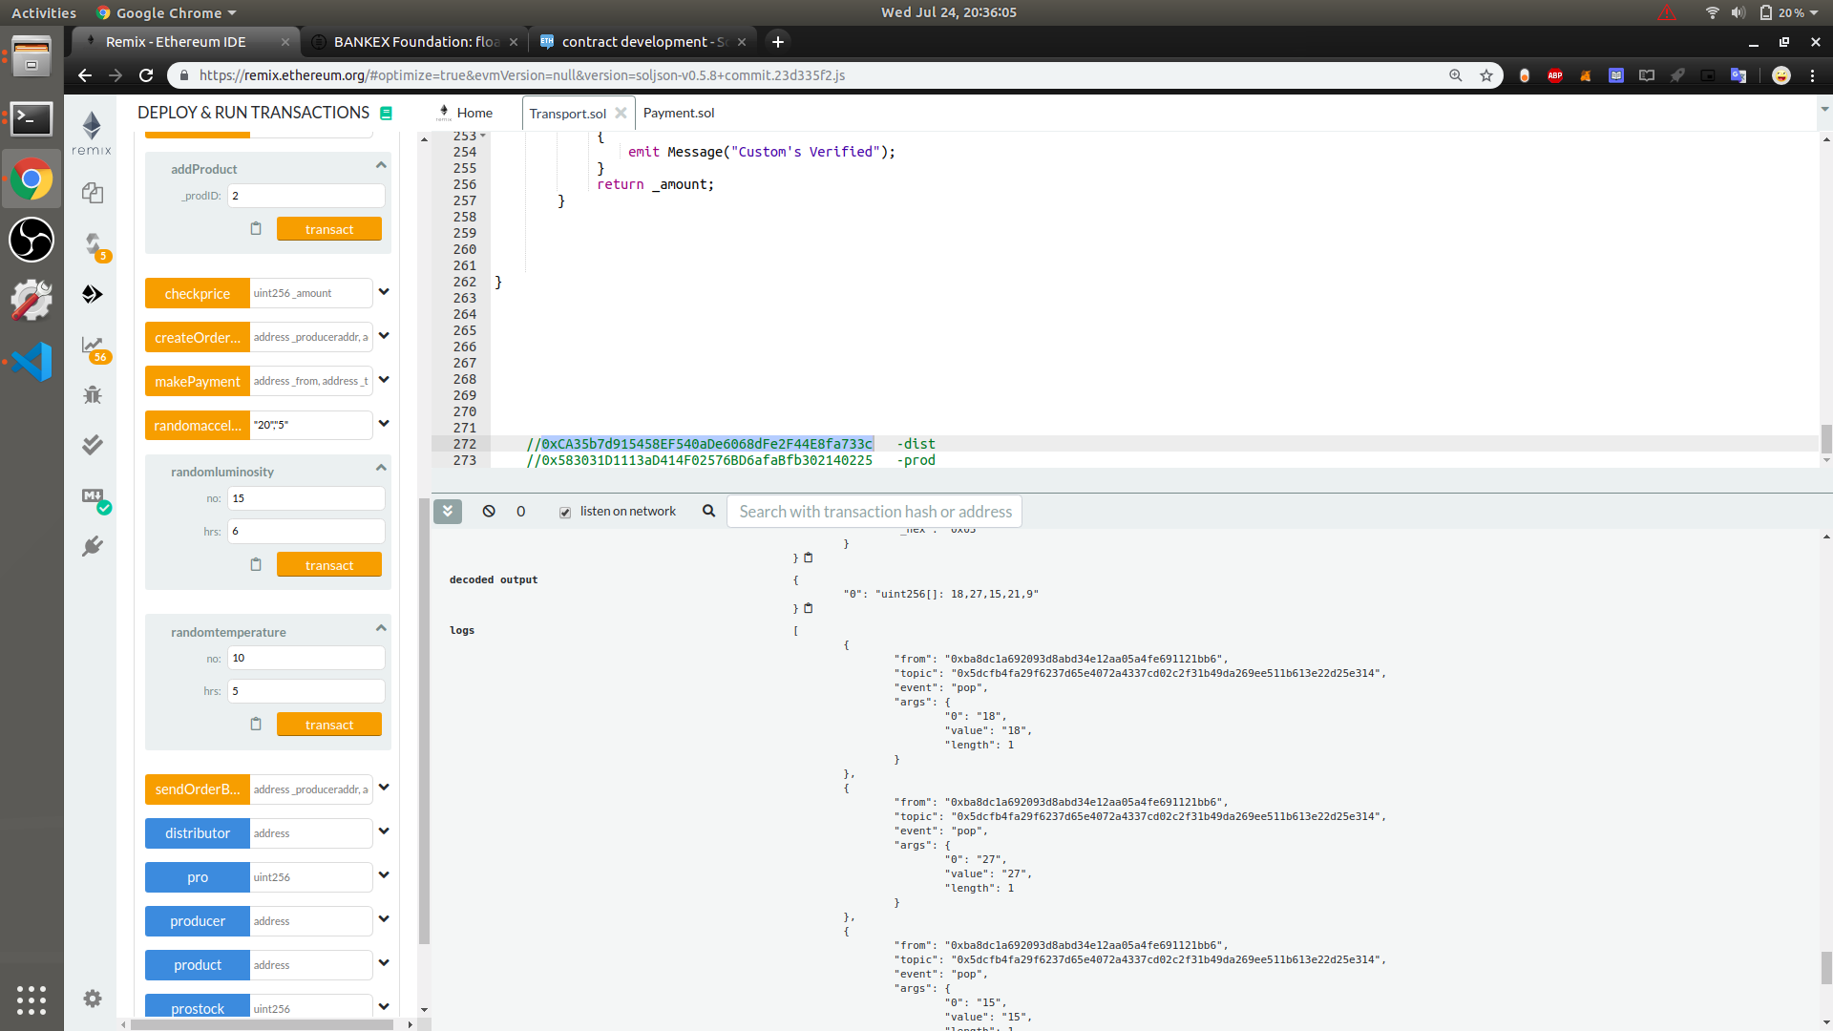
TEMPERATURE VALUE

Slide 21
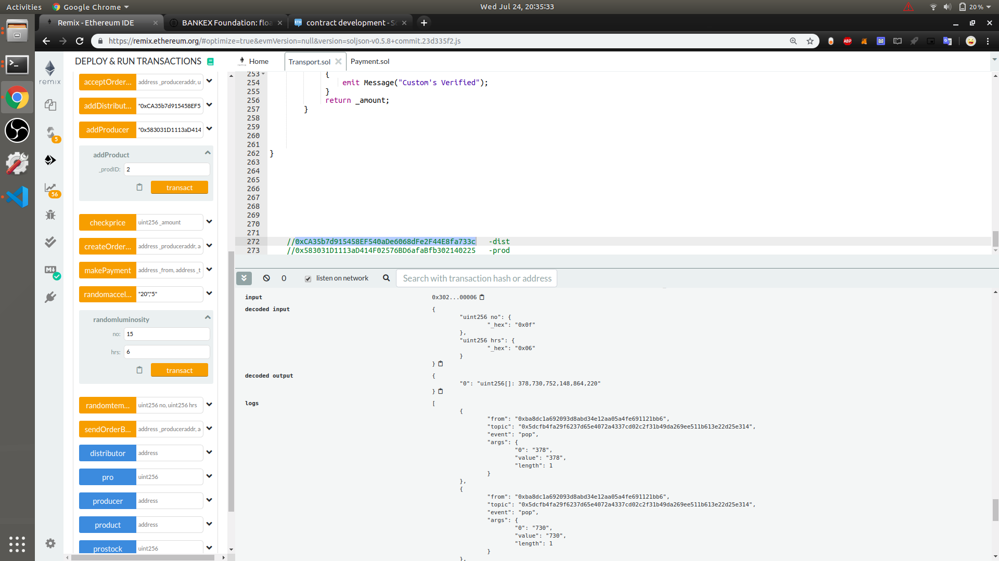
LUMINOSITY VALUES

Slide 22
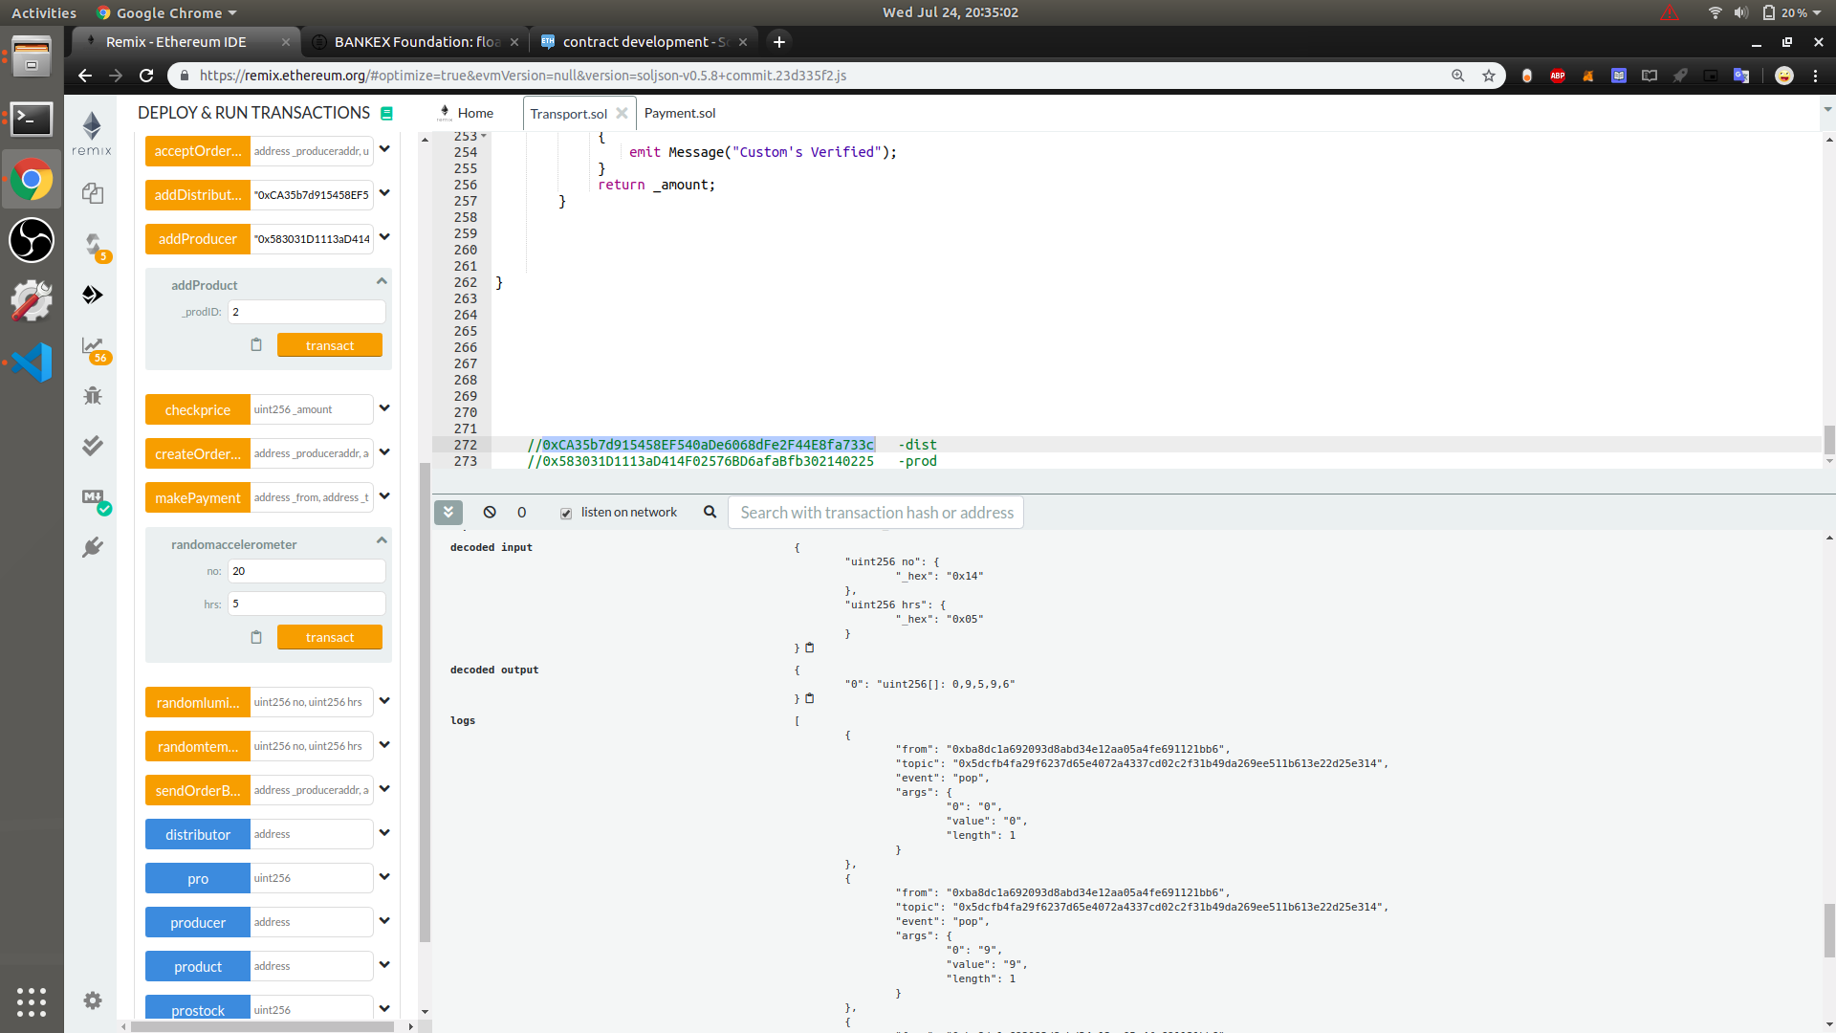
ACCELEROMETER VALUES

Slide 23
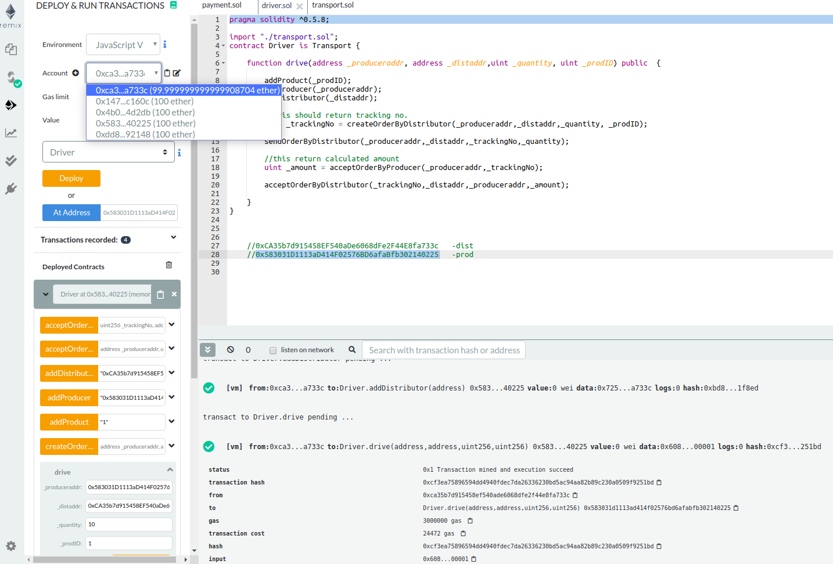
BEFORE PAYMENT

Slide 24
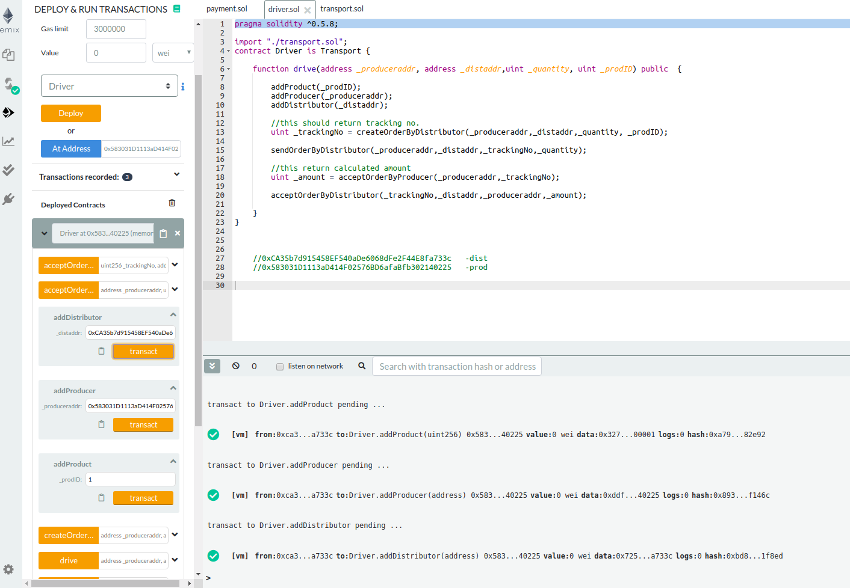
DEPLOYED PROJECT

Slide 25
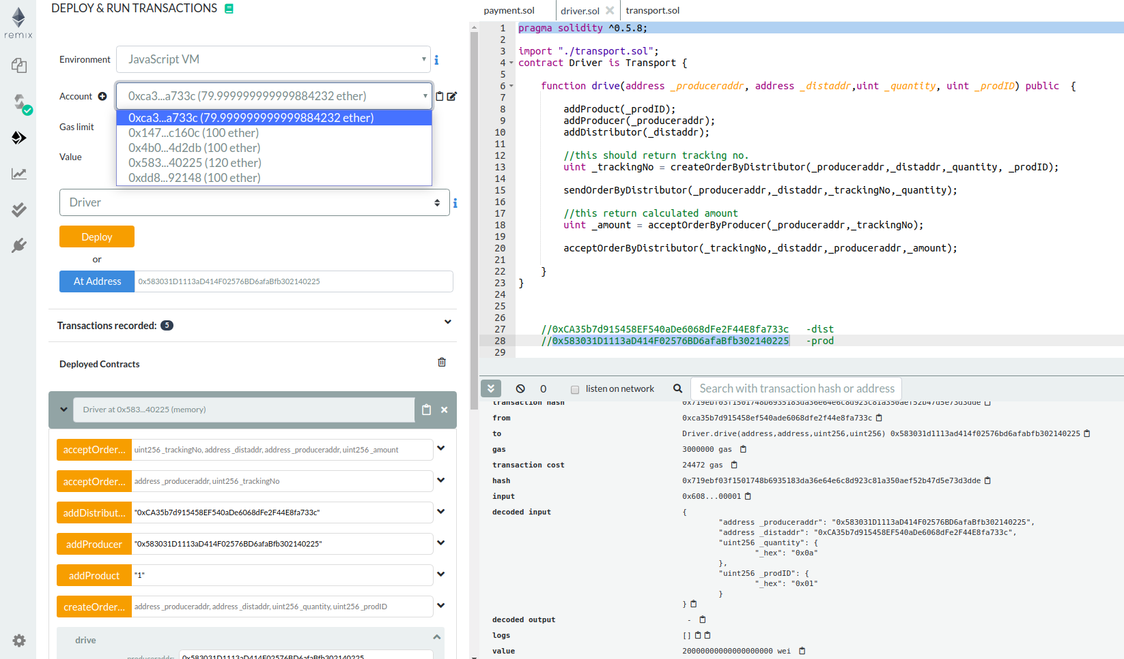
PAYMENT CHANGES REFLECTED

Slide 27
Conclusion
We have designed a basic working model of A Blockchain-based Application for a Transportation of Sensitive Goods , using IoT simulated sensor data to keep track on quality of sensitive goods(wine).

Slide 28
References
https://www.youtube.com/watch?v=vWnFei-ugT8
https://cryptozombies.io/ -slack
https://blockgeeks.com/guides/solidity/ -slack
https://medium.com/@robbertvermeulen/learn-solidity-the-ethereum---smart-contract-programming-language-7f106fc26d6
http://solidity.readthedocs.io/en/v0.4.24/units-and-global-variables.html

Slide 29

ANY QUESTIONS ???

